Slide 1
Bio211 Biostatistics and Experimental Design Winter Term 2018
Lecture 10 Multiple Regression
January 31, 2018

Slide 2
Outline for today
Assignment 9 due before lecture
MANOVA
Multiple regression
Independent work/questions

Slide 3
MANOVA
Multiple analysis of variance
2+ numeric dependent variables and one categorical independent variable
Are the multiple dependent variables affected by the independent variable?
What have we done that would use this?

Slide 4
Example in R

Slide 5
Multiple Regression
Two or more continuous effect variables
Predict or estimate an unknown Y value corresponding to a set of X values.
Understand the functional relationships between the dependent and independent variables to try to see what might be causing the variation in the dependent variable
Notes:
Walk through the bio handbook example http://rcompanion.org/rcompanion/e_05.html

Slide 6
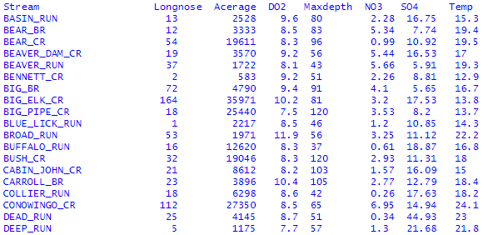
Example
Which of these factors is most important to the number of Longnose fish?

Slide 7
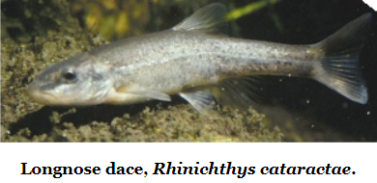
Don’t know what a Longnose is?

Slide 8
Multiple Regression
Y =a+b₁X₁+b₂X₂+b₃X₃...
Y = expected value of Y for a given set of X values
a = intercept
b₁ = estimated slope of a regression of Y on X₁, all other X variables kept constant
so on for b₂, b₃, etc

Slide 9
Variable Selection
“It is easy to throw a big data set at a multiple regression and get an impressive-looking output. However, many people are skeptical of the usefulness of multiple regression, especially for variable selection. They argue that you should use both careful examination of the relationships among the variables, and your understanding of the biology of the system, to construct a multiple regression model that includes all the independent variables that you think belong in it. This means that different researchers, using the same data, could come up with different results based on their biases, preconceived notions, and guesses; many people would be upset by this subjectivity. Whether you use an objective approach like stepwise multiple regression, or a subjective model-building approach, you should treat multiple regression as a way of suggesting patterns in your data, rather than rigorous hypothesis testing.”
Handbook of Biological Statistics

Slide 10
Forward variable selection
Add in one variable one by one and test the fit

Slide 11
Backward variable selection
Start with all variables and extract variables one by one and evaluate the fit

Slide 12
Example in R
We’re not going to go through the whole thing, but for your interest:
http://rcompanion.org/rcompanion/e_05.html

Slide 13
Summary
Animal behavior lab this afternoon
FRIDAY! I will either see you at 8:15 with your final paper in hard copy and get your exam by 10:00
OR
I will see your final exam in my inbox at 8:15 and see you at 9:40 with your final paper in hard copy

